Slide 1

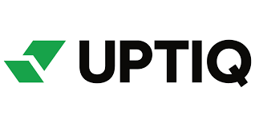
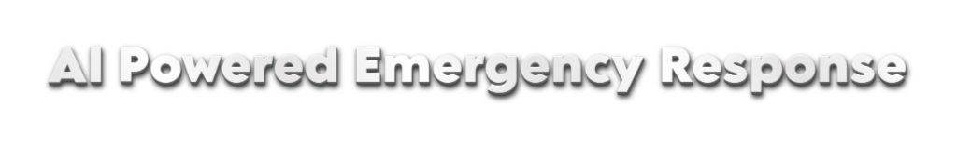

Team Name : Neural noMads
Domain : HealthCare

Slide 2
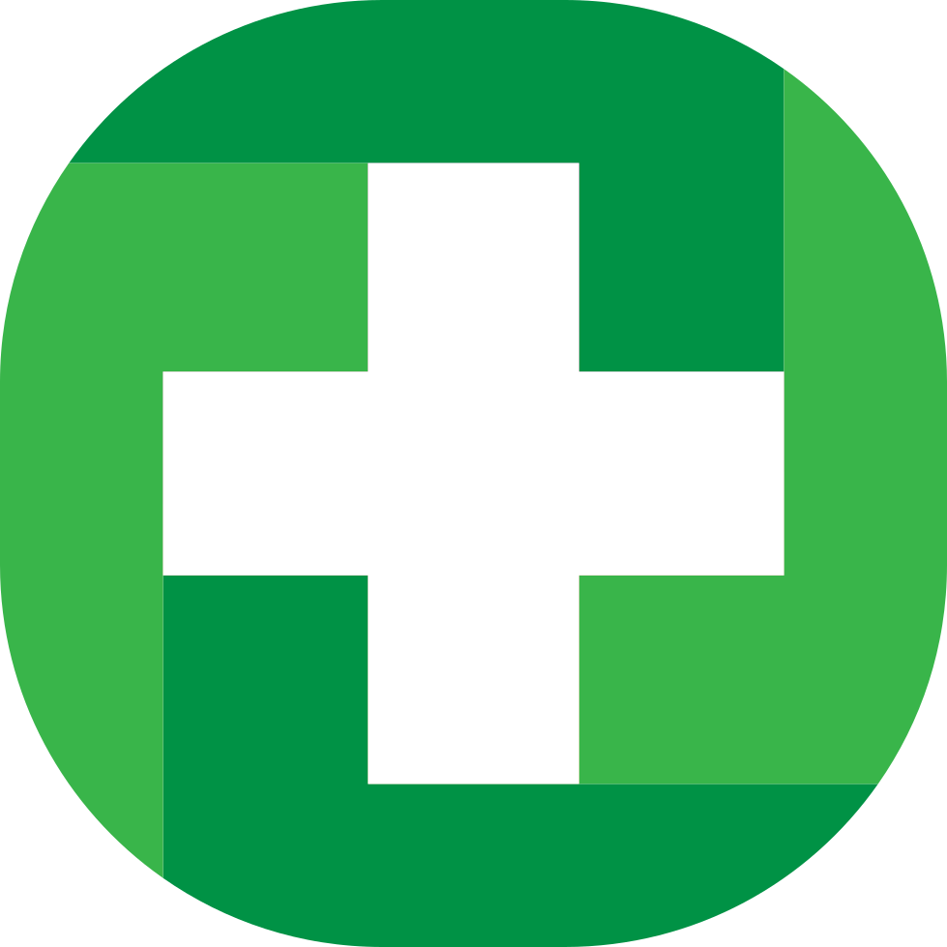
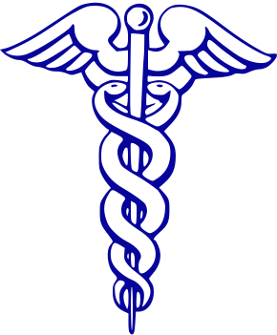
Problem Statement :
In critical medical emergencies, people often struggle to find accurate first-aid guidance quickly. Delays in administering the right response can lead to severe complications or fatalities. Our AI-powered emergency response agent provides real-time, step-by-step assistance for handling medical emergencies, ensuring immediate and correct action before professional help arrives.
?
Can AI Be Your First Responder in a Medical Emergency
How Can We Eliminate Panic-Driven Delays? – Providing instant, step-by-step guidance during medical crises.
What If Everyone Had Life-Saving Knowledge at Their Fingertips? – Empowering users with real-time first aid instructions.
How Can We Make Emergency Assistance More Accessible? – Offering multilingual, easy-to-follow support for diverse users.
When Should You Act or Call for Help? – AI-powered smart decision-making to guide critical actions.

Slide 3




Uniqueness
Instant AI Diagnosis: Quickly analyzes wound images to determine severity.
Personalized First-Aid Advice: Provides step-by-step treatment based on wound type.
Early Infection Detection: Identifies infection risks using AI.
Seamless Medical Guidance: Suggests whether home care is sufficient or a doctor visit is needed.
Key-Features
Image-Based Wound Assessment – AI analyzes wound images for severity and infection risk.
Personalized Treatment Suggestions – Provides first-aid guidance based on wound type.
Urgency Detection – Alerts users if medical attention is required.
Healthcare Connectivity – Recommends nearby hospitals and pharmacies.
Healing Progress Tracker – Monitors wound recovery with periodic assessments.
Symptom-Based Query Support – Users can describe symptoms for AI-driven advice.

Slide 4
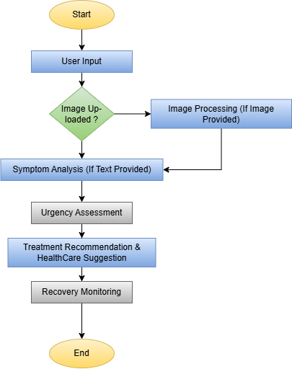
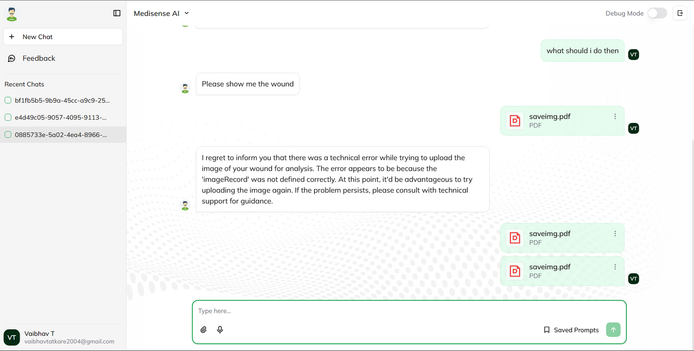
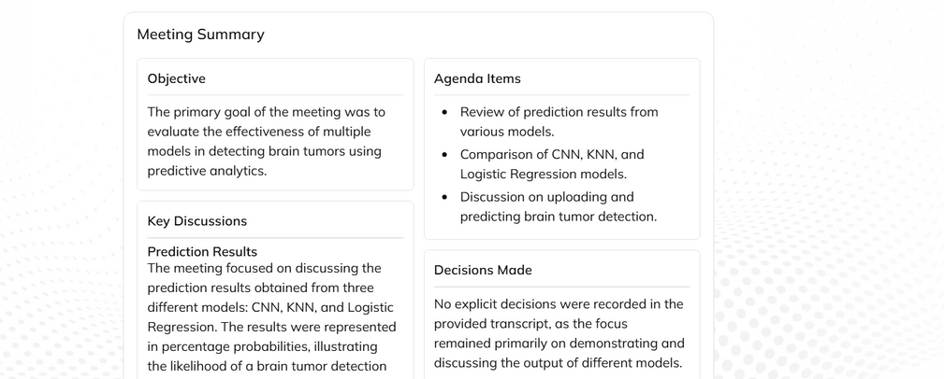
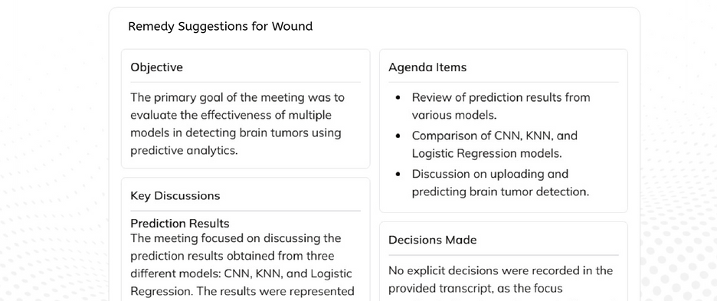
Implementation :
Workflow :

Slide 5
Conclusion
The AI-Powered Wound Analysis and First-Aid Assistant provides an innovative and accessible solution for quick medical assessments. By leveraging AI to analyze images and symptoms, it offers accurate treatment recommendations and urgency assessments. This system enhances healthcare accessibility, reduces unnecessary hospital visits, and ensures timely medical intervention when needed. Future enhancements could integrate telemedicine support and real-time doctor consultations for a more comprehensive healthcare solution.
Team Name :
Neural noMads
Member Name | Email | Phone
Vaibhav Tatkare | vaibhavtatkare04@gmail.com | 9892481044
Sumit Yesade | sumityesade14@gmail.com | 9004681406

